Slide 1
Budget Manager
Guide by:-
MR .Hardik Jayswal
Prepared by:-
20DIT036 Ashish Madan
20DIT050 Ayush PATEL

Slide 2
OVERVIEW
Introduction
Definition
Current System
Requirement Gathering Technique
Tools and Technologies
Project planning
Implementation

Slide 3
Introduction
This document is meant to delineate the features of the budget manager, to serve as a guide to the developers on one hand, and a software validation document for the prospective client on the other.
The budget manager for your income application this is use for how many money use in life important material and waste other money to buy extra product so we calculate money ratio and show the display than user see his income is where is use.

Slide 4
Background Theory(Literature Review)
We find our family member , neighbor and relatives to find where is income goes and he does not find where he/she spend a money.
So we develop this kind of application .
The user his enter there plan in the app and file the form then show where his/her money goes.

Slide 5
Current System and its limitations(if applicable)
The current system is a we find all old paper an pen system we find but we have doesn't find perfect ratio of where our money goes.
So we develop this kind of application .
In this app find the perfect ratio of our money where it’s gone.

Slide 6
Proposed System and Scope of the System
In our daily life we does not have time to calculate over every day money where go it’s so this website use to find your money ratio .
User can find it’s ratio and user can reduce it’s extra spend money to unnecessary product user invest money to some important and future savings..

Slide 7
Hardware Specifications
Laptop / Pc
Memory : 2 GB Ram
Processor : i5
Operating System : Windows 10
Internal : 256 GB SDD
Software Specifications
Software Specifications
Android studio
Xml & java

Slide 8
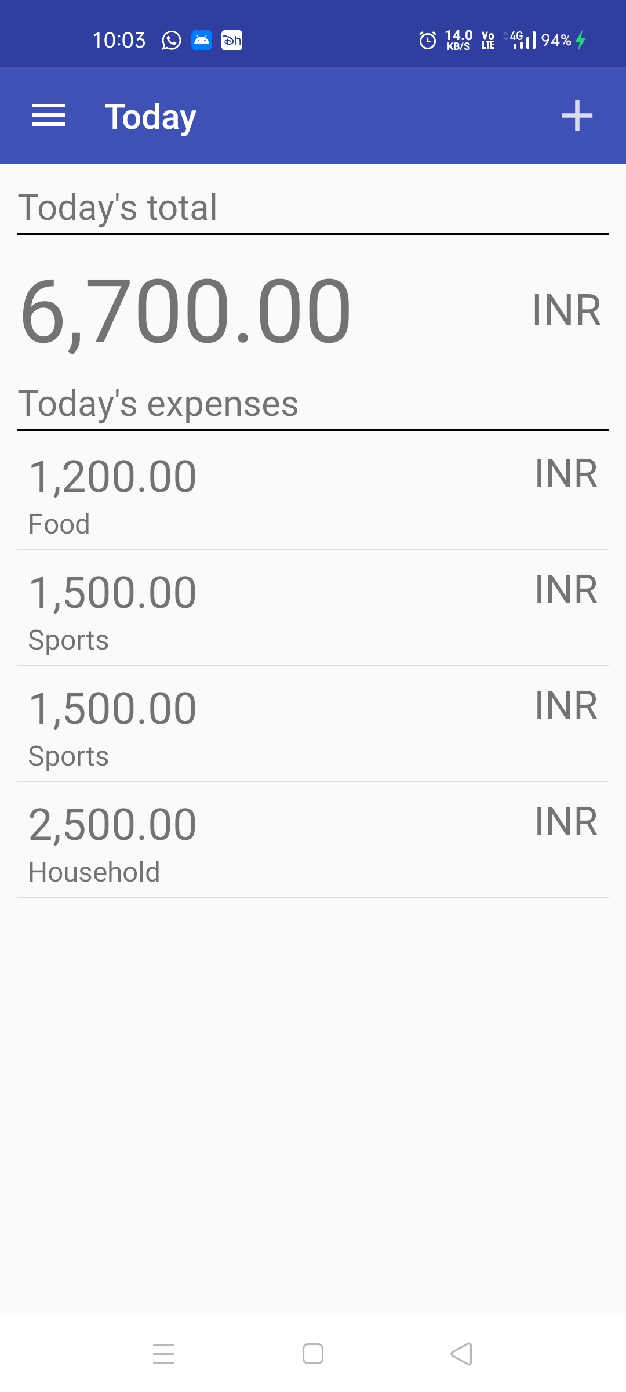
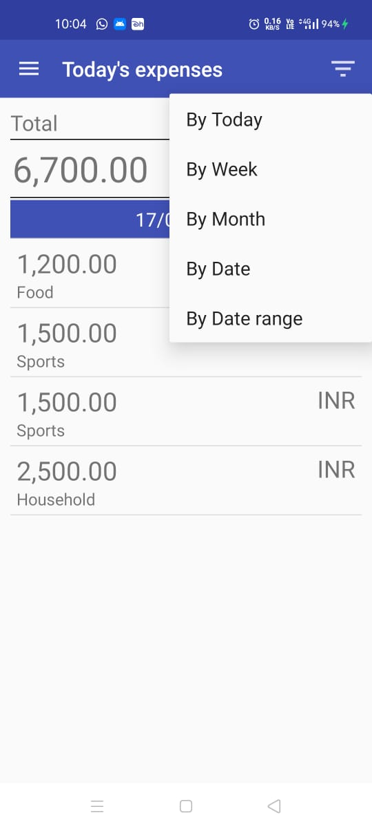
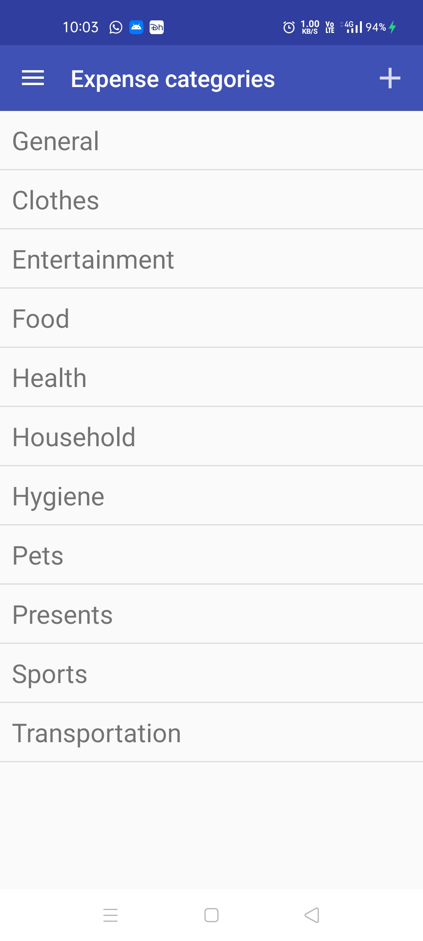
Implementation

Slide 9
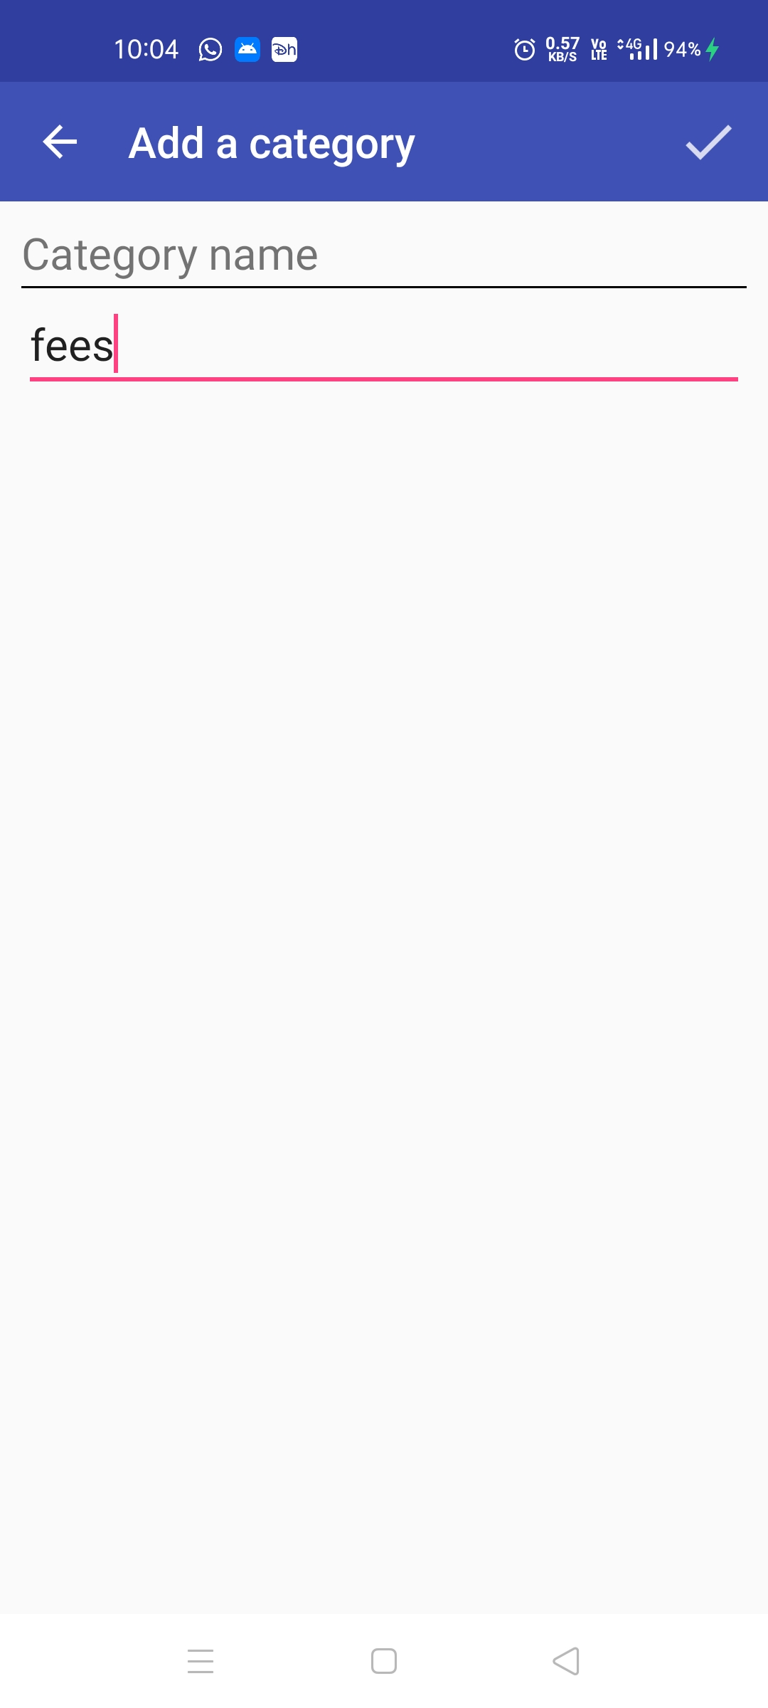
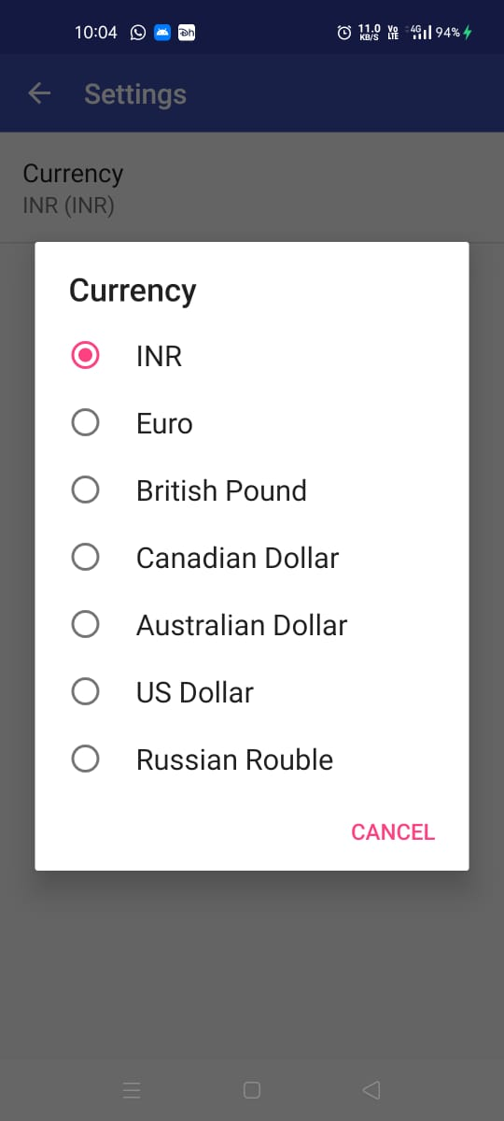
Implementation

Slide 10
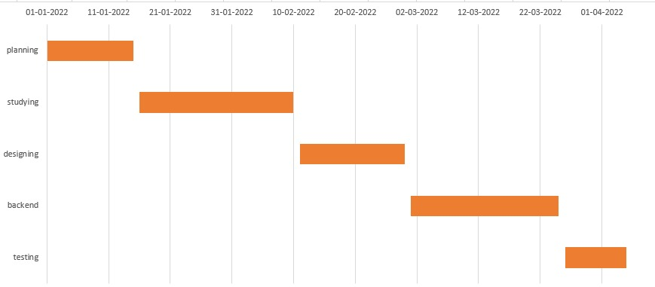
Project Definition and Planning(Gantt Chart)
Budget managers are responsible for ensuring that the expenses of the accounts managed do not exceed the unit's allocated budget.

Slide 11
Thank you !

